Slide 1
Shortest Path Algorithms

Slide 2

SINGLE-SOURCE SHORTEST PATH PROBLEM
Single-Source Shortest Path Problem - The problem of finding shortest paths from a source vertex v to all other vertices in the graph.

Slide 3
DIJKSTRA'S ALGORITHM

Slide 4
DIJKSTRA'S ALGORITHM
Dijkstra's algorithm - is a solution to the single-source shortest path problem in graph theory.
Works on both directed and undirected graphs. However, all edges must have nonnegative weights.
Input: Weighted graph G={E,V} and source vertex v∈V, such that all edge weights are nonnegative
Output: Lengths of shortest paths (or the shortest paths themselves) from a given source vertex v∈V to all other vertices

Slide 5
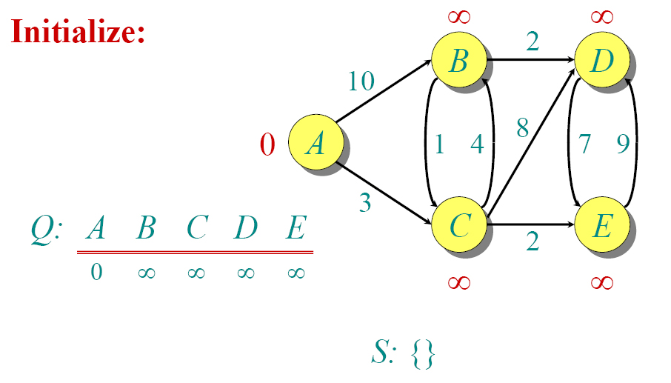
DIJKSTRA EXAMPLE

Slide 6

DIJKSTRA EXAMPLE

Slide 7

DIJKSTRA EXAMPLE

Slide 8

DIJKSTRA EXAMPLE

Slide 9

DIJKSTRA EXAMPLE

Slide 10

DIJKSTRA EXAMPLE

Slide 11

DIJKSTRA EXAMPLE

Slide 12

DIJKSTRA EXAMPLE

Slide 13

DIJKSTRA EXAMPLE

Slide 14

DIJKSTRA EXAMPLE

Slide 15
DIJKSTRA'S ALGORITHM - PSEUDOCODE
dist[s] ←0 (distance to source vertex is zero)
for all v ∈ V–{s}
do dist[v] ←∞ (set all other distances to infinity)
S←∅ (S, the set of visited vertices is initially empty)
Q←V (Q, the queue initially contains all vertices)
while Q ≠∅ (while the queue is not empty)
do u ← mindistance(Q,dist) (select the element of Q with the min. distance)
S←S∪{u} (add u to list of visited vertices)
for all v ∈ neighbors[u]
do if dist[v] > dist[u] + w(u, v) (if new shortest path found)
then d[v] ←d[u] + w(u, v) (set new value of shortest path)
return dist

Slide 16
DIJKSTRA-COMPLEXITY
Dijkstra's algorithm is structurally identical to BFS. However, it is slower because the priority queue is computationally more demanding than the constant-time pop and push of BFS.
Runtime analysis using a binary heap:
BuildPriorityQueue takes O(|V|).
ExtractMin and Insert are executed |V| times each – once for each node, thus it takes O(|V|log|V|).
In the worst case, DecreaseKey can be executed for every edge, thus |E| times, giving O(|E|log|V|). Overall we get O((|V|+|E|)log|V|)

Slide 17

RUNNİNG TİME ANALYSİS OF
DİJKSTRA’S ALGORİTHM
Look at different Q implementation, as did for Prim’s algorithm
Linear
Unsorted O(V²+E)
Array:
Binary Heap: O(VlgV+ElgV) = O(ElgV)
Fibonacci heap: O(VlgV+E)

Slide 18
DIJKSTRA'S ALGORITHM - WHY USE IT?
As mentioned, Dijkstra’s algorithm calculates the shortest path to every vertex.
However, it is about as computationally expensive to calculate the shortest path from vertex u to every vertex using Dijkstra’s as it is to calculate the shortest path to some particular vertex v.
Therefore, anytime we want to know the optimal path to some other vertex from a determined origin, we can use Dijkstra’s algorithm.

Slide 19


APPLICATIONS OF DIJKSTRA'S ALGORITHM
- Traffic Information Systems are most prominent use
- Mapping (Map Quest, Google Maps)
- Routing Systems

Slide 20
DIJKSTRA’S ALGORITHM
If no negative edge weights, we can beat BF
Similar to breadth-first search
  Grow a tree gradually, advancing from vertices taken from a queue
Also similar to Prim’s algorithm for MST
  Use a priority queue keyed on d[v]

Slide 21
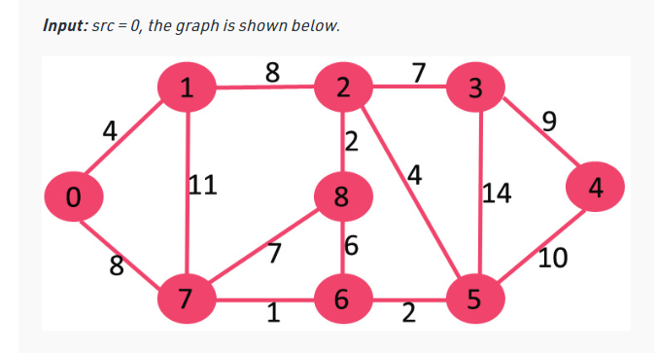
PRACTICE
https://www.geeksforgeeks.org/dijkstras-shortest-path-algorithm-greedy-algo-7/

